Slide 1

IMAGE CAPTION AND SPEECH GENERATION
USING LSTM AND GTTS API
Date: 09 April 2021
S. POOJA SAI SREE : 17WH1A0549
D. MANISHA: 17WH1A0524
S. SUSMITHA : 17WH1A0529
Internal Guide: Mr. K. BHARGAV RAM
Designation: Assistant Professor
Department of Computer Science & Engineering
BVRIT HYDERABAD College of Engineering for Women

Slide 2
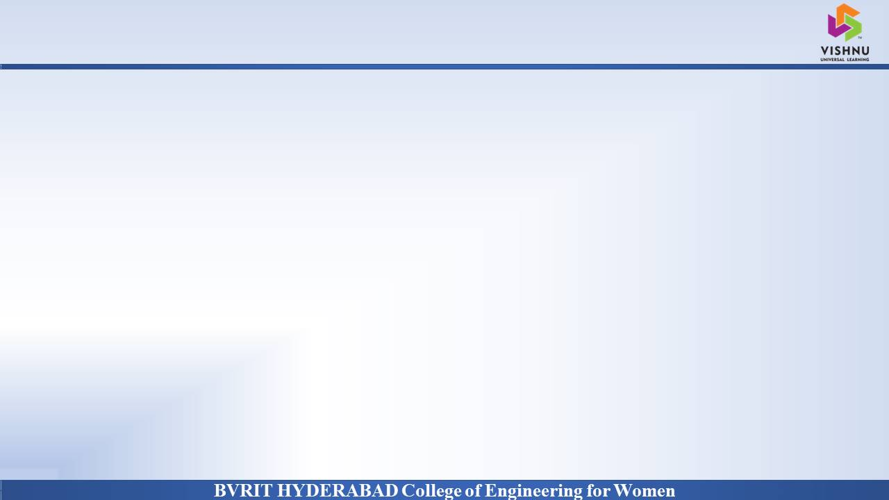
PROJECT INTRODUCTION
Why Should I Study this course?
Domain Name
AI/ML
Problem statement
Caption generation is a challenging artificial intelligence problem where a textual description must be generated for a given Image. This project aims to develop Image caption generator, a tool which generates captions or descriptions for an image according to the content observed. It also generates audio/speech for the description obtained. This can be done using Deep learning algorithms such as VGG16 model (CNN based), Long Short-Term Memory(Recurrent Neural Network) for generating captions and GTTS (Google Text To Speech) API for obtaining speech from description.
Examples
BVRIT HYDERABAD College of Engineering for Women

Slide 3
SYSTEM SPECIFICATIONS
Why Should I Study this course?
Examples
ENVIRONMENT | SPECIFICATIONS
HARDWARE | Processor - Intel Core i5 Memory(RAM) - 4 GB Storage – 500GB
SOFTWARE | Google Colab Python Window OS/Ubuntu
BVRIT HYDERABAD College of Engineering for Women

Slide 4
PROJECT PLAN
Why Should I Study this course?
SNO | REVIEW | DATES | TOPICS
1 | I-REVIEW | < > | -Software Requirements -Data preparation of images and text. - Features extraction
2 | II-REVIEW | < > | -Review-I slides - Development of model -Evaluation of model -Generation of speech from text
3 | III-REVIEW | < > | -Complete implementation -Results & Discussions -Project Report Draft
Examples
BVRIT HYDERABAD College of Engineering for Women

Slide 5
REFERENCES
Why Should I Study this course?
[1] Base paper
http://sersc.org/journals/index.php/IJAST/article/view/5927/3650
[2] Data Base source links
https://www.kaggle.com/adityajn105/flickr8k
Examples
BVRIT HYDERABAD College of Engineering for Women

Slide 6
Thankyou
BVRIT HYDERABAD College of Engineering for Women

